Slide 1

Dr. Ammar Haider
Assistant Professor
School of Computing
CS3002 Information Security
User Authentication

Slide 2
Authentication
Verifying the identity of the user connecting to a system (authenticator)
Once authenticated, system will proceed to check authorization
what resources user is authorized to access
what privileges they have

Slide 3
Means of Authentication
Something you know (knowledge)
password, pin, security Q/A
Something you have (possession)
mobile number, token (code generator), smartcard
Someone you are (biometrics)
fingerprint, facial features, voice
Something you do (behaviour)
typing rhythm, computer usage pattern, mouse movement, touch interaction, handwriting
Multifactor authentication: combining more than one modes from the above list

Slide 4
Authentication Types
Repudiable Authentication
involves factors, “what you know” and “what you have,”
the information presented can be unreliable because such factors suffer from several well-known problems
e.g. passwords can be leaked, possessions can be lost, forged, or easily duplicated.
Non-repudiable Authentication
involves characteristics whose proof of origin cannot be denied.
includes biometrics like iris patterns, retinal images, hand geometry
they positively verify the identity of the individual.

Slide 5
Implementing Authentication
Basic authentication involving a server
server maintains a file of usernames and passwords (or some other authenticating information)
client sends this information, which is examined by server and if correct, authorization is granted.
Challenge-response
the server or any other authenticating system generates a challenge to the host requesting for authentication and expects a correct response.
Centralized authentication
a central server authenticates users on the network and in addition also authorizes and audits them.

Slide 6
Password-based Authentication (something you know)

Slide 7
Password-based Authentication
secret = user’s password
User: provides their identity uid and proof (password)
System: verifies the proof
case #1:
system knows all user’s secrets in cleartext (!!!)
to check: proof == secret_{uid} ?
case #2: use one-way hash (digest)
system knows the digests of all user’s secrets
to check: hash(proof) == digest_{uid} ?

Slide 8
Passwords Pros
For users
Easy to remember (but if only for one system)
For system administrators
Easiest to implement, compared to other auth methods
Users are familiar with the concept, do not require training
Lowest cost: no specialized hardware needed

Slide 9
Passwords Cons
For users
can’t remember too many passwords
either use same password for multiple services !!!
or use simple easy to remember passwords
but that makes them guessable (son’s name!)
or use some form of password storage
post-it notes !!!
client-side password manager app (aka vault)
vulnerable to shoulder surfing, phishing, social engineering

Slide 10
Passwords Cons
For system administrators
password files are very frequently a stealing target for hackers. So, server-side password storage remains a challenge
hashing with a strong hash function is must
even hashed passwords are vulnerable to dictionary attacks
passwords are readable during transmission
encrypted channel is a must

Slide 11
Offline Password Cracking
When hackers manages to steal the password file from a service’s database, they immediately get a big dataset of hashed passwords.
Since hash is a one-way function, attacker needs guesswork and a lot of computation to work out the actual passwords.
make a guess g_{i}
compute h_{i} = hash(g_{i})
search h_{i} in the file. If found, a hash has been cracked, g_{i} is the revealed password.
loop back to step 1 until all hashes cracked

Slide 12
Offline Password Cracking
A naive way of guessing is to brute-force.
try every possible combination of letters, numbers, and symbols to guess a target password
quickly becomes infeasible when target passwords are longer
For a more selective brute forcing, attackers can use mask attacks – it assumes that target passwords follow a specific pattern
e.g. a common pattern is name and year (like sana2024). To crack such passwords, one can use a mask like ****#### where * is a lower-case letter and # is a digit.
Mask attacks greatly speed up the password search if certain characteristics of the password are known.

Slide 13
Offline Password Cracking
Other type of offline cracking is dictionary attack, where the password guesses are drawn from a list of commonly-used or previously-leaked passwords.
Such a list is called dictionary
These attacks require far less computing effort than brute forcing, but will only reveal passwords present in the dictionary.

Slide 14
Passwords: Salted storage
To thwart dictionary attacks, passwords can be salted.
At registration time, for each user UID:
create / ask for the password
generate a salt (a new random value for each user)
compute HP = hash ( password | salt )
i.e. concatenate password with salt before hashing
store the triples { UID, HP, salt_{UID} } in file

Slide 15
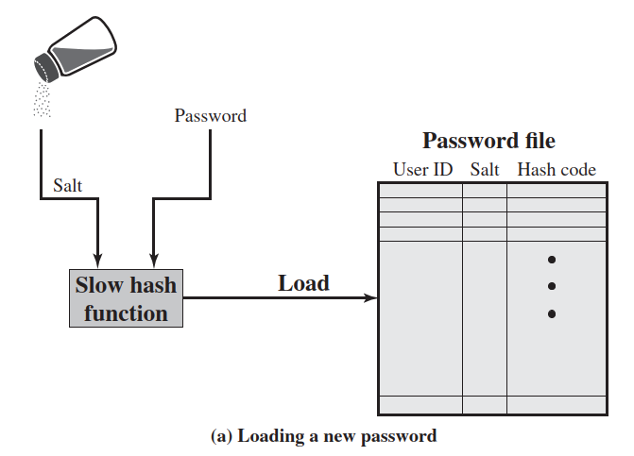
Passwords: Salted storage

Slide 16
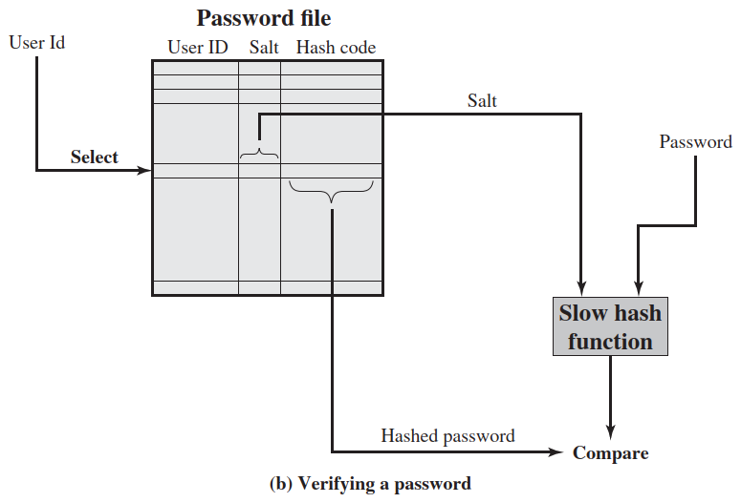
Passwords: Salted storage

Slide 17
Passwords: Salted storage
Advantages of salting
Prevents duplicate passwords from being visible in the password file (different HP for users having the same password).
Significantly increases the time complexity of offline dictionary attacks, since a unique salt is used for each user.
Makes it nearly impossible to tell if a person used the same password on multiple systems.

Slide 18
Remote User Authentication
Local authentication is safer
Login to personal computer
PIN input at ATM machine
Remote authentication problem
Eavesdroppers listening, looking for passwords
Solutions:
transmit password over an encrypted channel
i.e. manage the overhead of creating a secure channel first
use a challenge-response strategy

Slide 19
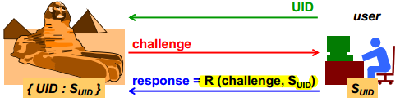
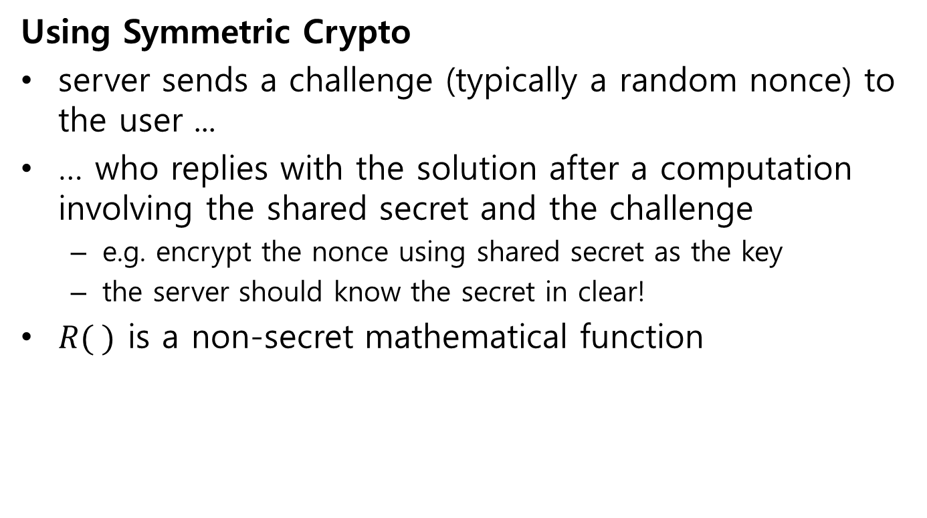
Challenge-response authentication
Using Symmetric Crypto
server sends a challenge (typically a random nonce) to the user ...
… who replies with the solution after a computation involving the shared secret and the challenge
e.g. encrypt the nonce using shared secret as the key
the server should know the secret in clear!
$R( )$ is a non-secret mathematical function

Slide 20
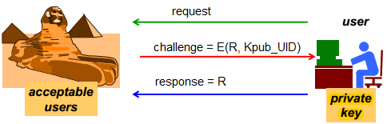
Challenge-response authentication
Using Asymmetric Crypto
server knows the public keys of all users
server sends a challenge to user: a random number R encrypted with the user’s public key ...
... and the users replies by sending R in clear thanks to its knowledge of the private key

Slide 21
Possession-based authentication (something you have)

Slide 22
Possession-based authentication
Possession-based authentication verifies a user’s identity using something they physically possess, such as a smartphone, hardware token, smart card, or security key.
Since there is a real danger of that physical object being stolen, possession-based authentication is typically used as a second factor of authentication (rather than the only factor).
A common way to implement it is via One-Time Passcodes (OTP).

Slide 23
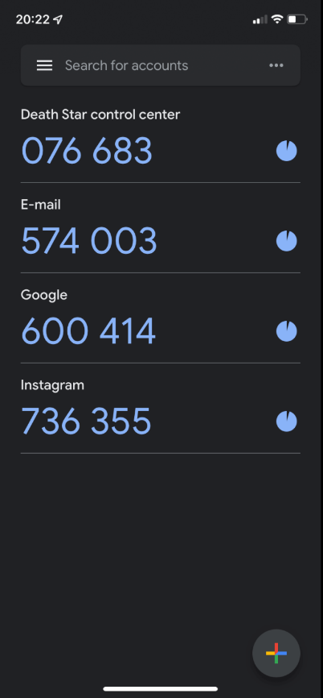
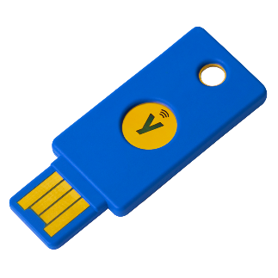
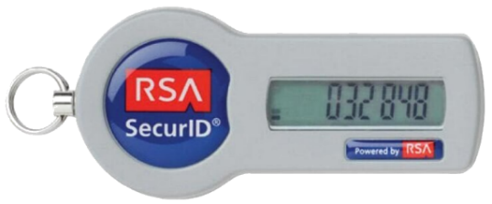
One-Time Passcodes (OTP)
An OTP is generated from a secret (seed).
The secret could be held by server only.
OTP is generated by server and sent to client’s second factor device (like mobile phone via call/sms)
Or the secret could be shared between client and server. So, the server verifies the OTP created at client side
generated and shown by a hardware token device
generated and shown by an app on smartphone
emitted by smart card or hardware keys (connected over USB, Bluetooth or NFC)
Code generator app
(google authenticator)
Hardware token
YubiKey

Slide 24
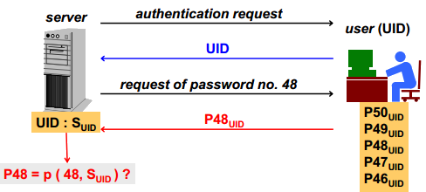
One-Time Passcodes (OTP)
Counter based one-time passwords
A secret value (seed) is securely handed over to client
At authentication time, OTP is calculated at the client using an increasing counter and seed
A one-way function is used for OTP calculation (why?)

Slide 25
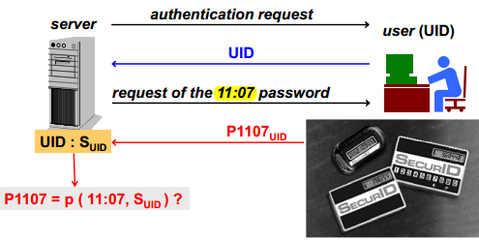
One-Time Passcodes (OTP)
Time based one-time passwords (TOTP)
A secret value (seed) is securely handed over to client
At authentication time, OTP is calculated at the client using the current time and seed
A one-way function is used for OTP calculation (why?)

Slide 26
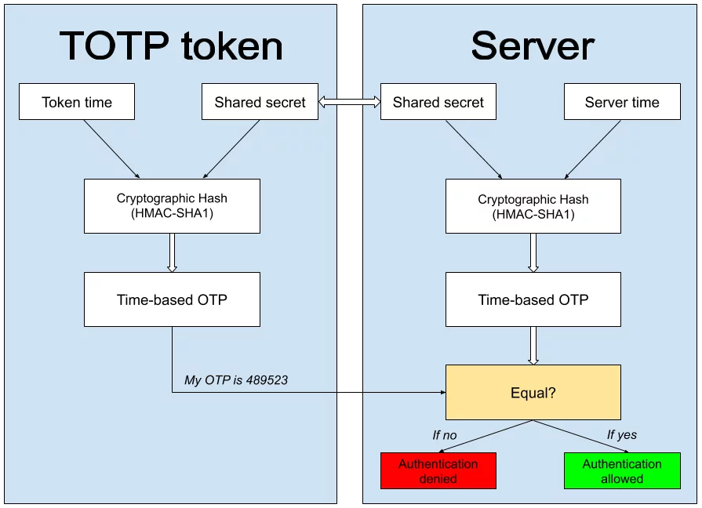
One-Time Passcodes (OTP)
https://www.protectimus.com/blog/totp-algorithm-explained/

Slide 27
SecurID: Architecture
SecureID is time-based synchronous OTP technique invented and patented by RSA security company
OTP is calculated as: P_{UID} ( t ) = f( SUID, t )
where SUID is the seed, and t is current time in minutes.
the client sends:
id, PIN, token-code (computed from seed and current time)
the server first verifies client’s PIN. Then it verifies the token against three possible values: TC-1, TC-0, TC+1
i.e. token code of past, current and future minute
will fail if there is a drift of more than one minute
wrong authentication attempts are limited

Slide 28
Biometric authentication (someone you are)

Slide 29
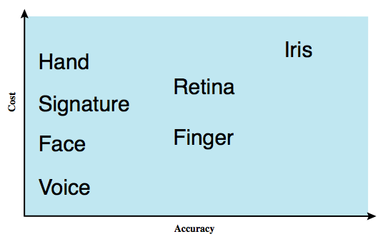
Biometric Authentication
Authenticate user based on one of their physiological characteristics:
facial features
fingerprint
hand geometry
palm vein pattern
retina vessel pattern
iris pattern
signature dynamics
voice

Slide 30
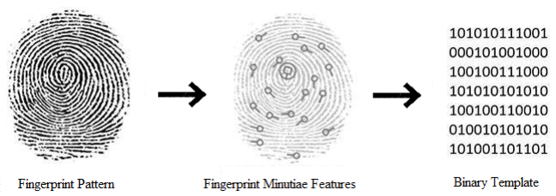
Features and Templates
Specialized sensors are used to capture the biometric data.
During enrollment, the raw data (image/audio) is not stored by itself. Instead, the system performs feature extraction to convert it into a digital, mathematical representation, called biometric template.
Template cannot easily be reverse-engineered back into the original biometric data, which is an important security and privacy measure.
https://www.researchgate.net/publication/354801909_Study_on_Introducing_Biometric_Fingerprint_Authentication_in_Automated_Student_Attendance_System

Slide 31
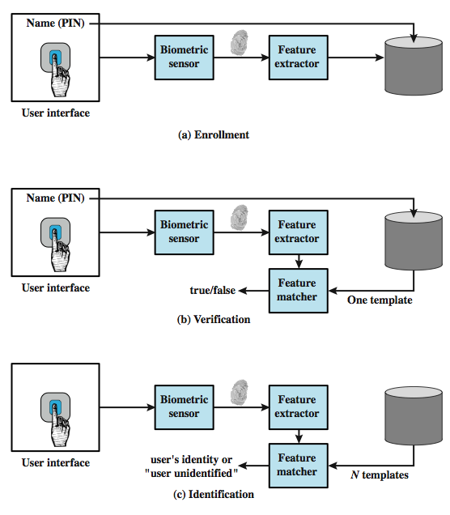
Operation of a biometric system
Enrollment means registration of a user’s template (unique trait)
Verification is when user provides their identity (username, PIN etc.) plus biometric data to get authenticated
Identification is when only biometric data is provided, system compares it with all the stored templates

Slide 32
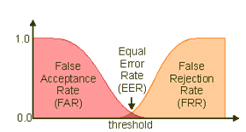
Template matching issue
Due to sensor noise and variability in human usage, there won’t be an exact match between any two biometric scan templates
So, system computes a similarity score (say 0 to 100). If the score is above some threshold, the user is accepted otherwise rejected
FAR = False Acceptance Rate FRR = False Rejection Rate
Using a higher threshold will reduce FAR (unauthorized users gaining access), at the cost of more genuine users getting blocked (high FRR)!
http://www.face-tek.com/e_bias_detail.php?BiasID=3

Slide 33
Other challenges in biometric auth
Biological characteristics are variable due to aging, wounds, swelling, wetness etc.
voice altered due to emotion or injury: https://youtu.be/iYhpbph4sLc
retinal blood pattern altered due to alcohol or drug
Persons with disability unable to use the system, so a fallback is needed
Extra hardware & logistical costs of sensors
No anonymous access possible

Slide 34
Centralized Multi-Service Authentication

Slide 35
Multi-Service Authentication
A typical enterprise environment has several application servers
e.g. sales management, knowledgebase, wiki, accounts, HR management, technical support
It will be too complex (and insecure) to store separate user credentials or keys on each application server
Solution: designate a single authentication server for all auth requests

Slide 36
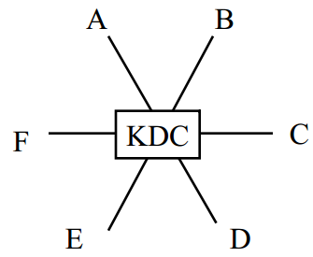
Key Distribution Center (KDC)
A solution for multi-party secure communication using symmetric cryptography
Each node is configured with a secret key, shared with KDC.
KDC has all the keys.
To initiate A ↔ B communication,
KDC sends a randomly generated session key K_{AB} encrypted with A’s key to A and encrypted with B’s key to B.
Now A and B can have a private conversation secured with K_{AB}

Slide 37
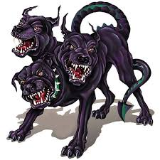
Kerberos
Network authentication protocol
Based on idea of using symmetric crypto
Maintain a KDC
Developed at MIT for project Athena
Named after Greek mythological character “Cerberus” – the three headed dog
Used by popular operating systems and servers
Protects against eavesdropping and replay attacks

Slide 38
Kerberos overview
Authentication server authenticates a user
TGS, Ticket Granting Server, grants ticket to the user, for a specific service in the network
Authentication server and TGS can be the same system. They work as a single unit.
Application Server provides the service to the user
The client, the KDC (auth. server + TGS) and the Application server are the 3 heads in kerberos

Slide 39
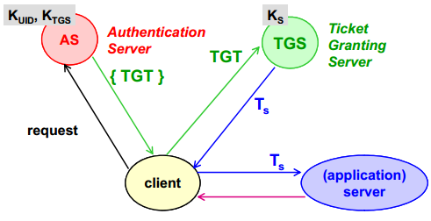
Kerberos High Level Working
TGT = ticket granting ticket T_{s} = service ticket
K_{UID} = secret key of user, pre-shared with AS
K_{S} = secret key of application server, pre-shared with TGS

Slide 40
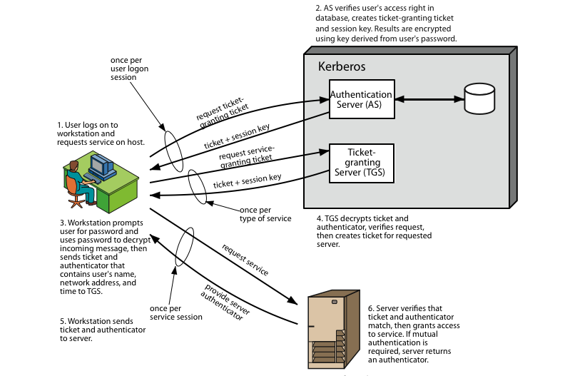
Kerberos Protocol

Slide 41
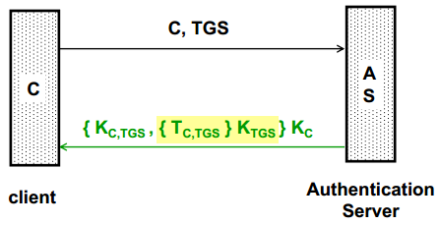
1-2. Client Authentication (Issue TGT)
Request
client send their id C, and ask for a ticket that will help them connect to ticket granting server TGS
this message is in plaintext
Response contains
K_{C,TGS} : the session key to connect to ticket granting server TGS
T_{C,TGS} : the ticket-granting ticket. It is encrypted with K_{TGS} (the secret key of TGS), not known to client
Whole response is encrypted with the secret key of client K_{C} (derived from their password)

Slide 42
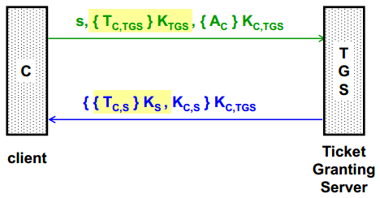
3-4. Client Authorization (Issue Service Ticket)
Request
s : id of the service that client wants to use
Encrypted TGT (yellow highlighted)
A_{C} : an authenticator message from client, proving his identity to TGS. It is encrypted by this session’s key K_{C,TGS}
Response
T_{C,S} : service ticket, encrypted with key of application server K_{S} (not known to client)
K_{C,S} : A session key for use between client and application server
Whole message is encrypted by this session’s key K_{C,TGS}

Slide 43
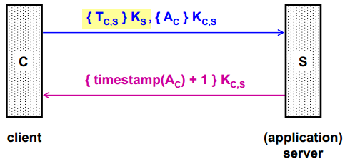
5-6. Client Service Request
Request
the encrypted service ticket (yellow highlighted)
A_{C} : an authenticator message containing client ID and timestamp. It is encrypted by this session’s key K_{C,S}.
Response
Timestamp in client’s message plus 1, encrypted by this session’s key K_{C,S} . It is a confirmation to client that server is ready to serve it.

Slide 44
References
Stallings SPP chap 3, 23
Kerberos on Computerphile: https://youtu.be/qW361k3-BtU
Kerberos message exchange in full detail https://youtu.be/5N242XcKAsM

